Slide 1
DEAC
Distance Education Advisory Committee
Tuesday May 28th, 2019 12:30pm-1:30pm

Slide 2
CCC Zoom & Agenda
Quorum was not met so no meeting was held.

Slide 3
DEAC Voting Members
Voting members of committee:
(Quorum=6 members need to be present to vote)
DSPS/ADA Rep- Cliff Seymour
Student Rep- Nicholas Robinson
Academic Affairs Rep Committee Co-Chair- Dr. Rodney Murray
Counseling - Eckko Blake
Division 1 Rep- Dr. Kent Schwitkis
Division 2 Rep- Mandida Uch
Division 3 Rep- Dr. Malinni Roeun
Student Services Rep- Syria Purdom
MIS Rep- Andrei Yermakov
Curriculum Committee Chair- Dr. Roza Ekimyan
DE Faculty Coord. Committee Co-Chair- Jasmine Phillips

Slide 4
Previous meeting minutes
Recommended Action: It is recommended that DEAC approves the previous meeting minutes as presented.
Motion:
Second:
March 26, 2019 meeting

Slide 5
DE Updates
Division 1, 2 & 3 Reps Report - Dr. Schwitkis, Dr. Roeun & Uch
Curriculum Report - Dr. Ekimyan
Senate Report -DEFC
DECO: Report -DEFC (new 3rd definition of DE)
New items:
Canvas Implementation
IEPI Plan
CVC-OEI Implementation
Blackbelt Help Presentation
Update on the requests that Dr. Curry made to DEAC

Slide 6
Canvas Implementation
Compton Canvas is up and running!!
No course shells yet, but summer online and hybrid faculty do have a sandbox to prepare summer courses in and several emails have gone out to notify them
We need an LMS person to create course shells
LMS Staff:
Per Dr. A, an LMS part-timer is being hired to create summer faculty course shells and ensure that faculty and students are synced into those shells from Banner/Ellucian
Andrei is in charge of the Banner setup
We should have our full time LMS person hired in the summer.
Dr. A has stated that she is working on getting other contracts signed for payment to make Canvas a robust system in addition to the CVC-OEI resources
TurnItIn: Plagiarism Resource
Etudes: Records Contract
Etudes: Adjust All
Etudes: CourseEvalHQ

Slide 7
IEPI Plan
The IEPI concluded the following information:
Link to the IEPI Plan & recommendation to make a Local POCR subsenate committee
Next Steps:
Review and incorporate feedback from CEO
Senate & CEO sign and return the plan to the IEPI
Receive the funding
Implement the plan
Document and measure our progress and success
Be ready to present our findings when the grant cycle continues
Apply for more funding next grant cycle

Slide 8
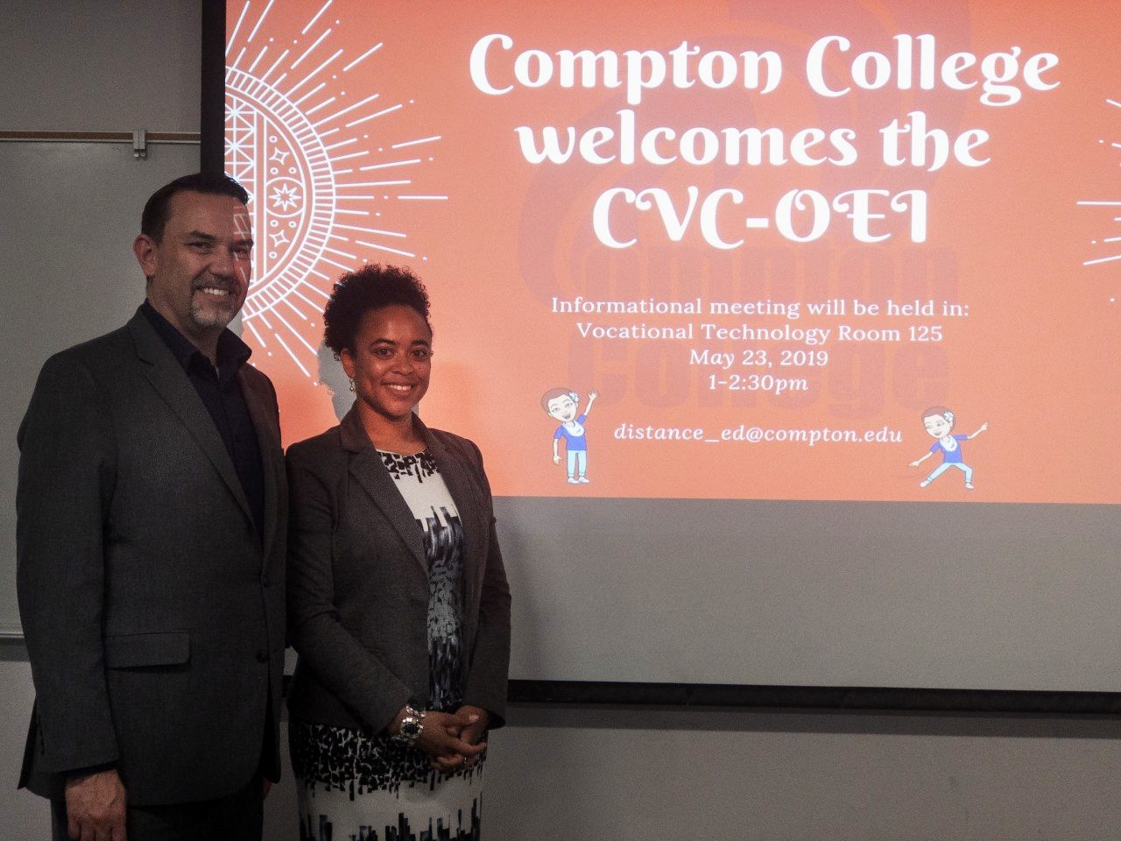
CVC-OEI
CVC-OEI visited on May 23rd from 1-2:30pm to provide information about becoming the 57th consortium college.
The president has signed the Master Consortium Agreement
The consortium provides the following resources at this link.
Kate stated that a next steps document will be sent to us soon.
Training counselors:
Cranium Cafe has a 6 week course that counselors can enroll in

Slide 9
Blackbelt Help Update
The VP of Academic Affairs referred the DEFC to contact Blackbelthelp on September 18, 2018 to see if this was something that we would want to purchase.
On Monday October 8th, 2018 Matt Brown of Blackbelthelp presented the following powerpoint to the DEFC and Andrei Y.
Link to presentation given by Blackbelthelp
Blackbelthelp is a company that would be able to provide support to Compton College as a campus in all departments.
This is not only a service for Distance Education which is why the DEFC forwarded the recommendation to the office of the VP of Academic Affairs to move forward with making a decision about the campus regarding information technology support.
It is the position of the DEFC that support for the campus is vital to the success of Compton College and that purchasing a support service like Blackbelthelp would be a great idea.
Canvas does provide after hours and weekend support for students that have technical and login issues.

Slide 10
Update on the visit from President Dr. Curry
Dr. Curry stated that he would like DEAC to:
Review the LMS position and make recommendations on job duties:
The DEFC sent multiple job summaries to HR per Dr. Curry’s request in Fall 2018
Gema sent us her new job classification as well
Have Andrei present to the committee on BlackBelt help
The contract with BlackBelt Help went before the board at the April 19th Board Meeting.
Generate a plan moving forward addressing if we should offer fully online programs
It is the responsibility of Curriculum Committee to determine what programs we offer and in what capacity.
Determine if we as a campus should increase our online offerings
Outside the purview of DEAC, refer to institutional research and planning
Construct a path to offering online resources to students such as online counseling etc.
In progress by joining the CVC-OEI
Find out where the money should come from to pay the POCR’s
Recommended to go another route to accomplish Local POCR as a subsenate committee

Slide 11
Next Meeting
Topics to discuss:
Guided Pathways Division representatives to reflect the new structure on campus
Implementation of DE Plan/Goals
Establishing what best practices are for Compton College
Invite professional development to provide a list of trainings for faculty
Evaluating DE progress through measurable outcomes and data
Program Plan and Unit Plan
We will need a new student rep
Congrats on graduating Nick!
DEAC Adjunct Rep: Stephanie Eaves
2019-2020 DEAC meeting times.
2nd tuesdays of each month from 12:30-1:30pm

Slide 12
DE Resources
@One Course Resources
First Fridays with @one
Byte Sized Canvas with @one
Flex Reporter is Live at Compton College
OEI Rubric; OEI 2018 Rubric
OEI Course Design Guide
OTC Conference 2019 Anaheim, CA June 17-19, 2019: Submit paperwork
Instructurecon July 9-11th in Long Beach: Submit paperwork
DE Meeting Notes

Slide 13
Meeting Attendees
Jasmine Phillips
Nick Robinson
Carlos Maruri
Don Mason
Meeting adjourned at: Motion: Second:

